Slide 1
RegEx
by Yaroslav Vendysh

Slide 2
Intro
Regular expressions are patterns used to match character combinations in strings.
Regular expressions are patterns that provide a powerful way to search and replace in text.
A regular expression can be a single character, or a more complicated pattern.
In JavaScript, regular expressions are available via the RegExp object.

Slide 3
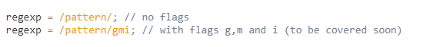
Syntax
A regular expression consists of a pattern and optional flags.
There are two syntaxes that can be used to create a regular expression object.
The “long” syntax:
And the “short” one, using slashes /:

Slide 4
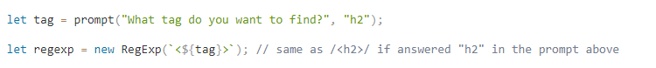
Syntax
In both cases regexp becomes an instance of the built-in RegExp class.
Syntax new RegExp, is more often used when we need to create a regexp “on the fly”.
While slashes are used when we know the regular expression at the code writing time.

Slide 5
Flags
Regular expressions may have flags that affect the search.
There are only 6 of them in JavaScript:
g global search
i case-insensitive search
m multi-line search
s allows . to match newline characters
u treat a pattern as a sequence of unicode code points
y "sticky" search that matches starting at the current position

Slide 6
Character classes
A character class is a special notation that matches any symbol from a certain set:
\d digits
\D non \d
\s space symbols, tabs, newlines
\S non \s
\w latin letters, digits, underscore _
\W non \w
. any character if with the regexp s flag, otherwise any except a newline \n

Slide 7
Unicode
Flag u enables the support of Unicode in regular expression.
That means two things:
Characters of 4 bytes are handled correctly: as a single character, not two 2-byte.
Unicode properties can be used in the search: \p{…}.
With Unicode properties we can look for words in given languages, special characters etc.

Slide 8
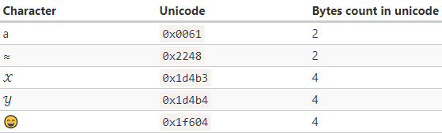
Unicode
Characters of 4 bytes are handled correctly: as a single character, not two 2-byte.
By default, regular expressions also treat 4-byte “long characters” as a pair of 2-byte ones.
Unlike strings, regular expressions have flag u that fixes such problems.

Slide 9
Unicode
Unicode properties can be used in the search: \p{…}.
Every character in Unicode has a lot of properties.
They describe what “category” the character belongs to, contain information about it:
letter, number, punctuation, mark, symbol, separator, other.
We can search for characters with a property, written as \p{…}.
To use \p{…}, a regular expression must have flag u.

Slide 10
Unicode [property values]
Letter [L]
lowercase [Ll]
modifier [Lm]
titlecase [Lt]
uppercase [Lu]
other [Lo]
Number [N]
decimal digit [Nd]
letter number [Nl]
other [No]
Punctuation [P]
connector [Pc]
dash [Pd]
initial quote [Pi]
final quote [Pf]
open [Ps]
close [Pe]
other [Po]

Slide 11
Unicode [property values]
Mark [M]
spacing combining [Mc]
enclosing [Me]
non-spacing [Mn]
Symbol [S]
currency [Sc]
modifier [Sk]
math [Sm]
other [So]
Separator [Z]
line [Zl]
paragraph [Zp]
space [Zs]

Slide 12
Unicode [property values]
Other [C]
conrol [Cc]
format [Cf]
not assigned [Cn]
private use [Co]
surrogate [Cs]

Slide 13
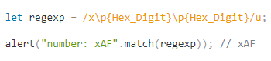
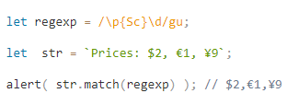
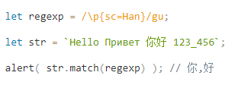
Unicode [examples]
Example: hexadecimal numbers
Example: currency symbols
Example: Chinese hieroglyphs

Slide 14
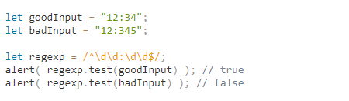
Anchors
The caret ^ and dollar $ characters have special meaning in a regexp - “anchors”.
The caret ^ matches at the beginning of the text, and the dollar $ – at the end.
Anchors ^ and $ are tests. They have zero width.
Anchors behave differently if flag m is present.

Slide 15
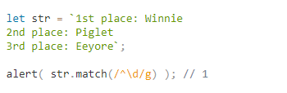
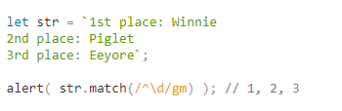
Anchors [multiline mode]
The multiline mode is enabled by the flag m, it only affects the behavior of ^ and $.
In the multiline mode they match not only at the beginning and the end of the string.
In the multiline mode they match at start/end of line too.

Slide 16
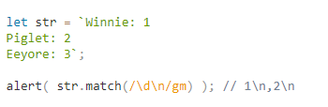
Anchors [newline character]
To find a newline, we can use not only anchors ^ and $, but also the newline character \n.
What’s the difference? Let’s see an example.
As we can see, there are 2 matches instead of 3.
Another difference: now every match includes a newline character \n.

Slide 17
Word boundary
A word boundary \b is a test, just like ^ and $.
There are three different positions that qualify as word boundaries:
At string start, if the first string character is a word character \w.
Between two characters in the string - one is a word character \w and the other is not.
At string end, if the last string character is a word character \w.
Note: word boundary \b doesn’t work for non-latin alphabets.

Slide 18
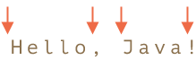
Word boundary [examples]
In the string “Hello, Java!” following positions correspond to \b:
So, it matches the pattern \bHello\b, because:
At the beginning of the string matches the first test \b.
Then matches the word “Hello”.
Then the test \b matches again, as we’re between “o” and a space.

Slide 19
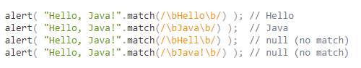
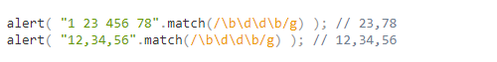
Word boundary [examples]
The pattern \bJava\b would also match. But not \bHell\b and not \bJava!\b.
We can use \b not only with words, but with digits as well.

Slide 20
Escaping
There are different special characters as well, that have special meaning in a regexp.
They are used to do more powerful searches.
Here’s a full list of them: [ \ ^ $ . | ? * + ( ).

Slide 21
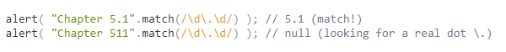
Escaping [examples]
Let’s say we want to find literally a dot. Not “any character”, but just a dot.
To use a special character as a regular one, prepend it with a backslash: \..
That’s also called “escaping a character”.

Slide 22
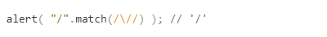
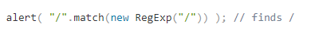
Escaping [a slash]
In JavaScript slash symbol / is used to open and close the regexp: /pattern/.
So we should escape it too, though it is not a special character.
Here’s what a search for a slash / looks like:
On the other hand, if we use new RegExp syntax, then we don’t need to escape it.

Slide 23
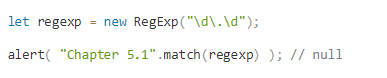
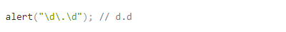
Escaping [new RegExp]
If we are creating a regular expression with new RegExp, we need do some other escaping.
The similar search in one of previous examples worked with /\d\.\d/.
Why? The reason is that backslashes are “consumed” by a string.

Slide 24
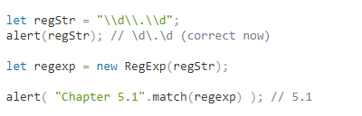
Escaping [new RegExp]
So new RegExp gets a string without backslashes. That’s why the search doesn’t work!
To fix it, we need to double backslashes, because string quotes turn \\ into \:

Slide 25
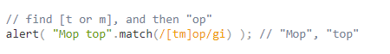
Sets and ranges
Several characters inside square brackets […] mean to “search for character among given”.
For instance, [eao] means any of the 3 characters: 'a', 'e', or 'o'.
That’s called a set.
Note: characters in set correspond to exactly one character in the match.

Slide 26
Sets and ranges
Several characters inside square brackets […] mean to “search for character among given”.
For instance, [a-z] is a character in range from a to z, and [0-5] is a digit from 0 to 5.
That’s called a ranges.
Note: characters in set correspond to exactly one character in the match.

Slide 27
Sets and ranges [excluding ranges]
Besides normal ranges, there are “excluding” ranges that look like [^…].
They are denoted the start and match any character except the given ones.

Slide 28
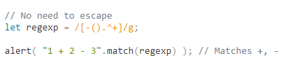
Sets and ranges [escaping]
In square brackets we can use the vast majority of special characters without escaping:
Symbols . + ( ) never need escaping.
A hyphen - is not escaped in the beginning or the end.
A caret ^ is only escaped in the beginning.
The closing square bracket ] is always escaped.

Slide 29
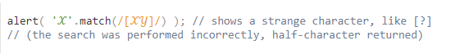
Sets and ranges [unicode]
If there are surrogate pairs in the set, flag u is required for them to work correctly.
For instance, let’s look for [𝒳𝒴] in the string 𝒳:
If we add flag u, then the behavior will be correct:

Slide 30
Quantifiers
A quantifier is appended to a character and specifies how many we need.
The simplest quantifier is a number in curly braces: {n}.
It has a few advanced forms, let’s see examples:
The exact count: {n}
The range: {a,b}, match a-b times
The range: {a,}, match a and more times

Slide 31
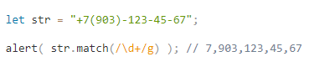
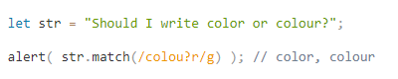
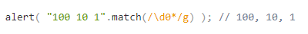
Quantifiers [shorthands]
There are shorthands for most used quantifiers:
+ Means “one or more”, the same as {1,}
? Means “zero or one”, the same as {0,1}
* Means “zero or more”, the same as {0,}

Slide 32
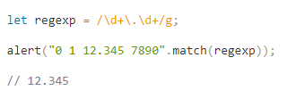
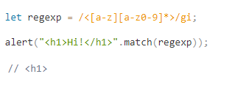
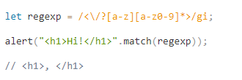
Quantifiers [examples]
Example: decimal fractions
Example: opening HTML-tag (no attr)
Example: complete HTML-tag (no attr)

Slide 33
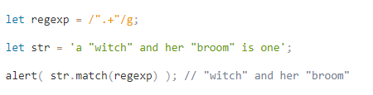
Quantifiers [greedy and lazy]
Quantifiers are very simple from the first sight, but in fact they can be tricky.
Let’s take the following task as an example.
We have a text and need to replace all quotes "..." with guillemet marks: «...».
A regular expression like /".+"/g may seem like a good fit, but it isn’t!

Slide 34
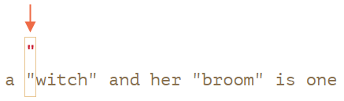
Quantifiers [greedy search]
The first pattern character is a quote ":

Slide 35
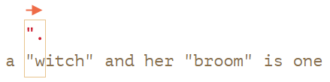
Quantifiers [greedy search]
The quote is detected, and then the engine tries to find a match for the rest.
It tries to see if the rest of the subject string conforms to .+":

Slide 36
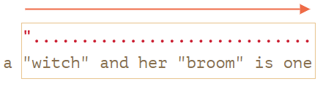
Quantifiers [greedy search]
Then the dot repeats because of the quantifier .+.
The regular expression engine adds to the match one character after another:

Slide 37
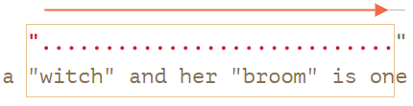
Quantifiers [greedy search]
Now the engine finished repeating .+ and tries to find the next character of the pattern.
It’s the quote ". There’s a problem: the string has finished, there are no more characters:

Slide 38
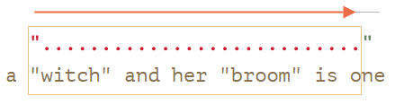
Quantifiers [greedy search]
…So the engine decreases the number of repetitions of .+ by one more character:

Slide 39
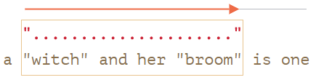
Quantifiers [greedy search]
The engine keep backtracking: it decreases the count of repetition for ..
Until the rest of the pattern (in our case ") matches:

Slide 40
Quantifiers [greedy and lazy]
The lazy mode of quantifiers is an opposite to the greedy mode.
It means: “repeat minimal number of times”.
We can enable it by putting a question mark ? after the quantifier,
So that it becomes *? or +? or even ?? for '?’.
To make things clear: usually a question mark ? is a quantifier by itself.
But if added after another quantifier it gets another meaning:
It switches the matching mode from greedy to lazy.

Slide 41
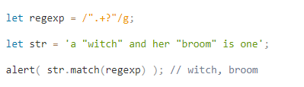
Quantifiers [greedy and lazy]
The regexp /".+?"/g works as intended: it finds "witch" and "broom":

Slide 42
Quantifiers [lazy mode]
The first step is the same: it finds the pattern start " at the 3rd position:

Slide 43
Quantifiers [lazy mode]
The next step is also similar: the engine finds a match for the dot .:

Slide 44
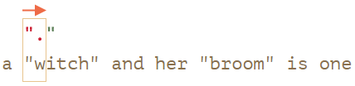
Quantifiers [lazy mode]
And now the search goes differently, because we have a lazy mode for +?.
The engine doesn’t try to match a dot one more time.
But stops and tries to match the rest of the pattern " right now:

Slide 45
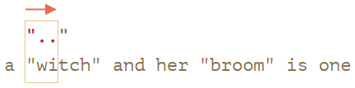
Quantifiers [lazy mode]
Then the regular expression engine increases the number of repetitions for the dot.
And tries one more time:

Slide 46
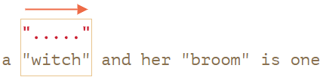
Quantifiers [lazy mode]
…Till the match for the rest of the pattern is found:

Slide 47
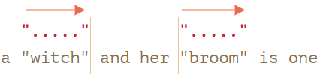
Quantifiers [lazy mode]
The next search starts from the end of the current match and yield one more result:

Slide 48
Quantifiers [greedy and lazy]
Conclusion:
In the greedy mode (by default) a quantifier is repeated as many times as possible.
The lazy mode of quantifiers is an opposite to the greedy mode.
It means: “repeat minimal number of times”.
Laziness is only enabled for the quantifier with ?.

Slide 49
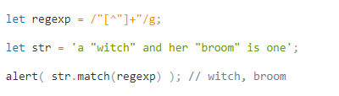
Quantifiers [alternative approach]
With regexps, there’s often more than one way to do the same thing.
In our case we can find quoted strings without lazy mode using the regexp [^"]+:
Please note, that this logic does not replace lazy quantifiers!
It is just different. There are times when we need one or another.

Slide 50
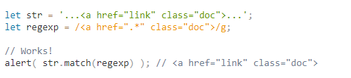
Quantifiers [alternative approach]
Let’s see an example where lazy quantifiers fail and this variant works right.
For instance, we want to find links of the form <a href="..." class="doc">, with any href.
The first idea might be:

Slide 51
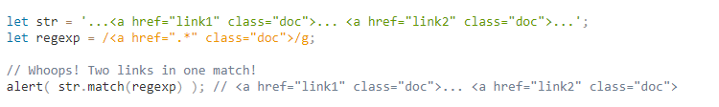
Quantifiers [alternative approach]
It worked. But let’s see what happens if there are many links in the text?

Slide 52
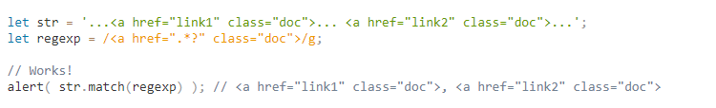
Quantifiers [alternative approach]
Let’s modify the pattern by making the quantifier .*? lazy:

Slide 53
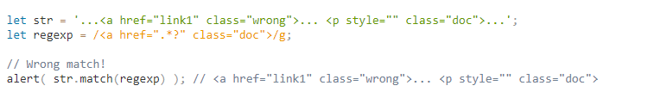
Quantifiers [alternative approach]
…But let’s test it on one more text input:

Slide 54
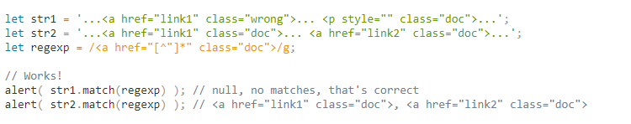
Quantifiers [alternative approach]
The correct variant can be: href="[^"]*".

Slide 55
Capturing groups
A part of a pattern can be enclosed in parentheses (...) - “capturing group”.
That has two effects:
If we put a quantifier after the parentheses, it applies to the parentheses as a whole.
It allows to get a part of the match as a separate item in the result array.

Slide 56
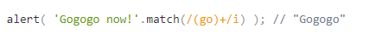
Capturing groups
If we put a quantifier after the parentheses, it applies to the parentheses as a whole.
Without parentheses, the pattern go+ means g character, followed by o repeated 1+ times.
For instance, goooo or gooooooooo.
Parentheses group characters together, so (go)+ means go, gogo, gogogo and so on.

Slide 57
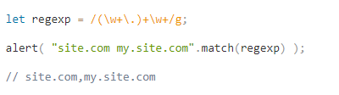
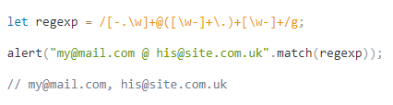
Capturing groups [examples]
Example: domain
Example: email

Slide 58
Capturing groups [match]
It allows to get a part of the match as a separate item in the result array.
Parentheses are numbered from left to right.
The method str.match(regexp), if regexp has no flag g, returns the first match as an array:
At index 0: the full match.
At index 1: the contents of the first parentheses.
At index 2: the contents of the second parentheses.
…and so on…

Slide 59
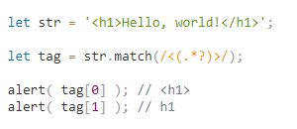
Capturing groups [match]
For instance, we’d like to find HTML tags <.*?>, and process them.
It would be convenient to have tag content, in a separate variable.
Now we’ll get both the tag as a whole <h1> and its contents h1 in the resulting array:

Slide 60
Capturing groups [nested groups]
Parentheses can be nested. In this case the numbering also goes from left to right.
For instance, when searching a tag in <span class="my"> we may be interested in:
The tag content as a whole: span class="my".
The tag name: span.
The tag attributes: class="my".

Slide 61


Capturing groups [nested groups]
Let’s add parentheses for them: <(([a-z]+)\s*([^>]*))>.
Here’s how they are numbered (left to right, by the opening parent):

Slide 62

Capturing groups [optional groups]
It could be that a group is optional and doesn’t exist in the match (has the quantifier (...)?).
The corresponding result array item is present and equals undefined.
The regexp a(z)?(c)? looks for "a" optionally followed by "z" optionally followed by "c".

Slide 63

Capturing groups [matchAll]
If we search for all matches (flag g), the match method does not return contents for groups.
For example, let’s find all tags in a string:
The result is an array of matches, but without details about each of them.
But in practice we usually need contents of capturing groups in the result.

Slide 64
Capturing groups [matchAll]
To get them, we should search using the method str.matchAll(regexp).
It was added to JavaScript language long after match, as its “new and improved version”.
Just like match, it looks for matches, but there are 3 differences:
It returns not an array, but an iterable object.
When the flag g is present, it returns every match as an array with groups.
If there are no matches, it returns not null, but an empty iterable object.

Slide 65

Capturing groups [matchAll]
For instance:
There’s no need in Array.from if we’re looping over results or using destructuring.

Slide 66


Capturing groups [matchAll]
There’s no need in Array.from if we’re looping over results or using destructuring.

Slide 67

Capturing groups [named groups]
Remembering groups by their numbers is hard, giving names to parentheses – better option.
That’s done by putting ?<name> immediately after the opening paren.
For example, let’s look for a date in the format “year-month-day”.

Slide 68

Capturing groups [replace]
Method replace allows to use parentheses contents in the replacement string.
That’s done using $n, where n is the group number.
For example,

Slide 69

Capturing groups [replace]
For named parentheses the reference will be $<name>.
For example, let’s reformat dates from “year-month-day” to “day.month.year”:

Slide 70
Capturing groups [non-capturing]
Sometimes we don’t want contents of parentheses in results – only apply a quantifier.
A group may be excluded by adding ?: in the beginning.
For instance, if we want to find (go)+.
But we don’t want the parentheses contents (go) as a separate array item, write: (?:go)+.

Slide 71

Capturing groups [non-capturing]
In the example below we only get the name John as a separate member of the match:

Slide 72

Backreferences
We can use the contents of capturing groups (...) in the pattern itself.
A group can be referenced in the pattern using \N, where N is the group number.
We need to find quoted strings: either single-quoted '...' or a double-quoted "...".

Slide 73

Backreferences
To make sure that the pattern looks for the closing quote exactly the same as the opening.
We can wrap it into a capturing group and backreference it: (['"])(.*?)\1.
Now it works!
The regular expression engine finds the first quote (['"]) and memorizes its content.

Slide 74

Backreferences [named backreferences]
If a regexp has many parentheses, it’s convenient to give them names.
To reference a named group we can use \k<name>.

Slide 75

Alternation
Alternation is the term in regular expression that is actually a simple “OR”.
In a regular expression it is denoted with a vertical line character |.
For instance, we need to find programming languages: HTML, PHP, Java or JavaScript.

Slide 76
Alternation
We already saw a similar thing – square brackets.
Square brackets allow only characters or character sets.
For instance, gr[ae]y matches gray or grey
Alternation allows any expressions.
For instance, "I love (HTML|CSS)" matches "I love HTML" or "I love CSS".

Slide 77

Alternation [examples]
Example: build a regexp for searching time in the form hh:mm, for instance 12:00.

Slide 78
Lookahead and lookbehind
Sometimes we need to find only matches that are followed or preceeded by another pattern.
There’s a special syntax for that, called “lookahead” and “lookbehind”, together - “lookaround”.
For the start, let’s find the price from the string like 1 turkey costs 30€.
That is: a number, followed by € sign.

Slide 79


Lookahead and lookbehind
Positive lookahead X(?=Y) - look for X, but match only if followed by Y.
Negative lookahead X(?!Y) - look for X, but match only if not followed by Y.

Slide 80


Lookahead and lookbehind
Positive lookbehind (?<=Y)X - look for X, but match only if after Y.
Negative lookbehind (?<!Y)X - look for X, but match only if not after Y.

Slide 81
Lookahead and lookbehind [groups]
Generally, the contents inside lookaround parentheses does not become a part of the result.
E.g. in the pattern \d+(?=€), the € sign doesn’t get captured as a part of the match.
But in some situations we might want to capture the lookaround expression, or a part of it.
Just wrap that part into additional parentheses.

Slide 82


Lookahead and lookbehind [groups]
In the example below the currency sign (€|kr) is captured, along with the amount:
And here’s the same for lookbehind:

Slide 83
Catastrophic backtracking
Some regular expressions are looking simple, but can execute veeeeeery long time.
The typical symptom – a regular expression works fine sometimes.
But for certain strings it “hangs”, consuming 100% of CPU.
In such case a web-browser suggests to kill the script and reload the page.
For server JavaScript it may become a vulnerability if regular expressions process user data.

Slide 84

Catastrophic backtracking
Let’s check if string consists of words \w+ with an optional space \s? after each.
We’ll use a regexp ^(\w+\s?)*$, it specifies 0 or more such words.

Slide 85

Catastrophic backtracking
If you run the example below, you probably won’t see anything, as JavaScript will just “hang”.
A web-browser will stop reacting on events, the UI will stop working.

Slide 86

Catastrophic backtracking
What’s the matter? Why the regular expression “hangs”?
Let’s simplify the example to understand it. So what’s wrong with the regexp?
First, one may notice that the regexp (\d+)* is a little bit strange.
The quantifier * looks extraneous. If we want a number, we can use \d+.

Slide 87


Catastrophic backtracking
First, the regexp engine tries to find a number \d+.
The plus + is greedy by default, so it consumes all digits:
Then it tries to apply the star quantifier, but there are no more digits.
The next in the pattern is the string end $, but in the text we have !, so there’s no match:

Slide 88

Catastrophic backtracking
As there’s no match, the greedy quantifier + decreases the count of repetitions.
So it backtracks one character back.
Now \d+ takes all digits except the last one:

Slide 89


Catastrophic backtracking
Then the engine tries to continue the search from the new position (9).
The star (\d+)* can be applied – it gives the number 9:
The engine tries to match $ again, but fails, because meets !:

Slide 90




Catastrophic backtracking
No match, so the engine will continue backtracking, decreasing the number of repetitions.
Backtracking generally works like this.
The last greedy quantifier decreases the number of repetitions until it can.
Then the previous greedy quantifier decreases, and so on.

Slide 91
Catastrophic backtracking
There are many ways to split a set of digits 123456789 into numbers.
To be precise, there are 2n-1, where n is the length of the set.
For n=20 there are about 1 million combinations, for n=30 – a thousand times more.
Trying each of them is exactly the reason why the search takes so long.
What to do? Should we turn on the lazy mode?
Unfortunately, that won’t help: if we replace \d+ with \d+?, the regexp will still hang.

Slide 92

Catastrophic backtracking
The similar thing happens in our first example.
When we look words by pattern ^(\w+\s?)*$ in the string an input that hangs!.
The reason is that a word can be represented as one \w+ or many:

Slide 93

Catastrophic backtracking [how to fix]
There are two main approaches to fixing the problem.
The first is to lower the number of possible combinations.
Why did the problem disappear? Now the star * goes after \w+\s instead of \w+\s?.
It became impossible to represent one word of the string with multiple successive \w+.

Slide 94
Catastrophic backtracking [how to fix]
It’s not always convenient to rewrite a regexp. And it’s not always obvious how to do it.
The alternative approach is to forbid backtracking for the quantifier.
The pattern to take as much repetitions of \w as possible without backtracking is: (?=(\w+))\1.
Lookahead ?= looks forward for the longest word \w+ starting at the current position.
Then the engine will memorize their contents - with help wrap \w+ into parentheses
…And allow us to reference it in the pattern as \1.

Slide 95

Catastrophic backtracking [how to fix]
Let’s rewrite the first example using lookahead to prevent backtracking:

Slide 96
Catastrophic backtracking [how to fix]
Conclusion:
The problem described in this article is called “catastrophic backtracking”.
We covered two ways how to solve it:
Rewrite the regexp to lower the possible combinations count.
Prevent backtracking.

Slide 97
Searching at position
The flag y allows to perform the search at the given position in the source string.
To search from the given position, we can use method regexp.exec(str).
If the regexp doesn’t have flags g or y - this method looks for the first match in the string str.
Exactly like str.match(regexp). Such simple no-flags case doesn’t interest us here.

Slide 98

Searching at position
If there’s flag g, then it performs the search in the string str, starting from some position.
This position stored in its regexp.lastIndex property.
And, if it finds a match, then sets regexp.lastIndex to the index immediately after the match.

Slide 99

Searching at position
Flag y makes regexp.exec to look exactly at position lastIndex, not before, not after it.
In such tasks like lexical analysis, there are usually many searches at an exact position.
Using flag y is the key for a good performance.

Slide 100
Methods of RegExp and String
Methods that work with regexps in-depth:
str.match(regexp)
str.matchAll(regexp)
str.split(regexp|substr, limit)
str.search(regexp)
str.replace(str|regexp, str|func)
regexp.exec(str)
regexp.test(str)

Slide 101

Methods of RegExp and String [match]
The method str.match(regexp) finds matches for regexp in the string str and has 3 modes:
If the regexp doesn’t have flag g.
It returns the first match as an array with capturing groups and properties index, input.

Slide 102

Methods of RegExp and String [match]
If the regexp has flag g.
It returns an array of all matches as strings, without capturing groups and other details.

Slide 103

Methods of RegExp and String [match]
If there are no matches, no matter if there’s flag g or not, null is returned.

Slide 104
Methods of RegExp and String [matchAll]
The method str.matchAll(regexp) is a “newer, improved” variant of str.match.
It’s used mainly to search for all matches with all groups.
Just like match, it looks for matches, but there are 3 differences:
It returns not an array, but an iterable object.
When the flag g is present, it returns every match as an array with groups.
If there are no matches, it returns not null, but an empty iterable object.

Slide 105

Methods of RegExp and String [matchAll]
Using example:

Slide 106
Methods of RegExp and String [split]
Splits the string using the regexp (or a substring) as a delimiter.
We can use split with strings, like this:
But we can split by a regular expression, the same way:

Slide 107

Methods of RegExp and String [search]
The method str.search(regexp) returns the position of the first match or -1 if none found.
We can use split with strings, like this:
The important limitation: search only finds the first match.
If we need positions of further matches, we should use str.matchAll(regexp).

Slide 108

Methods of RegExp and String [replace]
This is a generic method for searching and replacing, one of most useful ones.
We can use it without regexps, to search and replace a substring:
When the first argument of replace is a string, it only replaces the first match.

Slide 109


Methods of RegExp and String [replace]
To find all hyphens, we need to use a regexp /-/g, with the obligatory g flag:
The second argument is a replacement string. We can use special character in it:

Slide 110
Methods of RegExp and String [replace]
Full list of these character:
Symbols | Action in the replacement string
$& | inserts the whole match
$` | inserts a part of the string before the match
$' | inserts a part of the string after the match
$n | if n is a 1-2 digit number, inserts the contents of n-th capturing group
$<name> | inserts the contents of the parentheses with the given name
$$ | inserts character $

Slide 111
Methods of RegExp and String [replace]
For situations that require “smart” replacements, the second argument can be a function.
The function is called with arguments func(match, p1, p2, ..., pn, offset, input, groups):
match – the match,
p1, p2, ..., pn – contents of capturing groups (if there are any),
offset – position of the match,
input – the source string,
groups – an object with named groups.

Slide 112

Methods of RegExp and String [replace]
If there are no parentheses, then there are only 3 arguments: func(str, offset, input).
For example, let’s uppercase all matches and replace each match by its position:

Slide 113
Methods of RegExp and String [exec]
The method regexp.exec(str) method returns a match for regexp in the string str.
It behaves differently depending on whether the regexp has flag g.
If there’s no g, then regexp.exec(str) returns the first match exactly as str.match(regexp).
This behavior doesn’t bring anything new.

Slide 114
Methods of RegExp and String [exec]
But if there’s flag g, then:
A call to regexp.exec(str) returns the first match.
Then it saves the position immediately after it in the property regexp.lastIndex.
The next such call starts the search from position regexp.lastIndex,
It returns the next match and saves the position after it in regexp.lastIndex.
…And so on.
If there are no matches, regexp.exec returns null and resets regexp.lastIndex to 0.

Slide 115

Methods of RegExp and String [exec]
We can use regexp.exec to search from a given position by manually setting lastIndex.

Slide 116

Methods of RegExp and String [exec]
If we use flag y, then the search will be performed exactly at the position regexp.lastIndex.

Slide 117


Methods of RegExp and String [test]
The method regexp.test(str) looks for a match and returns true/false whether it exists.
For instance:

Slide 118

Methods of RegExp and String [test]
If the regexp has flag g, then regexp.test looks from regexp.lastIndex property.
And then it updates this property, just like regexp.exec.

Slide 119
Useful links
https://developer.mozilla.org/en-US/docs/Web/JavaScript/Guide/Regular_Expressions
https://www.w3schools.com/js/js_regexp.asp
https://javascript.info/regular-expressions
https://itnext.io/javascript-fundamentals-understanding-regex-fd81891375e0
https://eloquentjavascript.net/09_regexp.html
https://flaviocopes.com/javascript-regular-expressions/
https://regex101.com/

Slide 120
Thank you for attention
by Yaroslav Vendysh

